Slide 1
Chapter 7
Introduction to Structured Query Language (SQL)

Slide 2
Learning Objectives
In this chapter, you will learn:
  The basic commands and functions of SQL
  How to use SQL for data administration (to create tables and indexes)
  How to use SQL for data manipulation (to add, modify, delete, and retrieve data)
  How to use SQL to query a database for useful information

Slide 3
Structured Query Language (SQL)
Categories of SQL function
  Data definition language (DDL)
  Data manipulation language (DML)
Nonprocedural language with basic command vocabulary set of less than 100 words
Differences in SQL dialects are minor

Slide 4
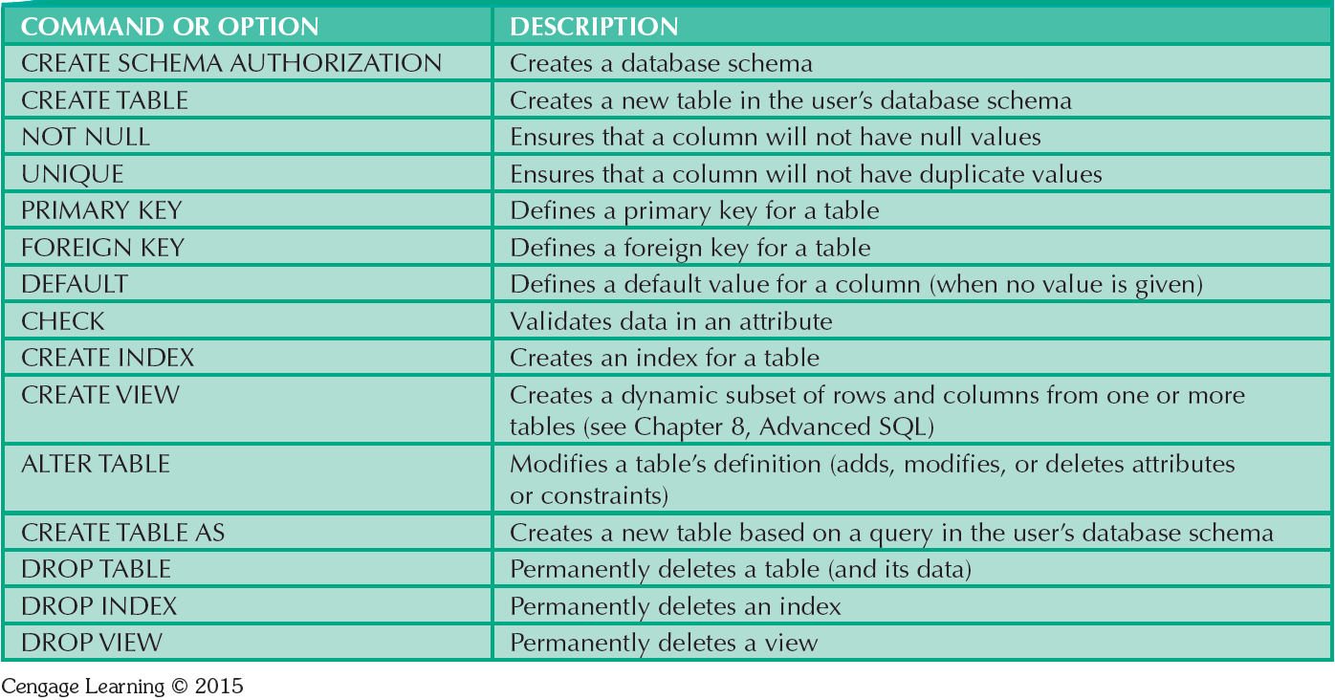
Table 7.1 - SQL Data Definition Command

Slide 5
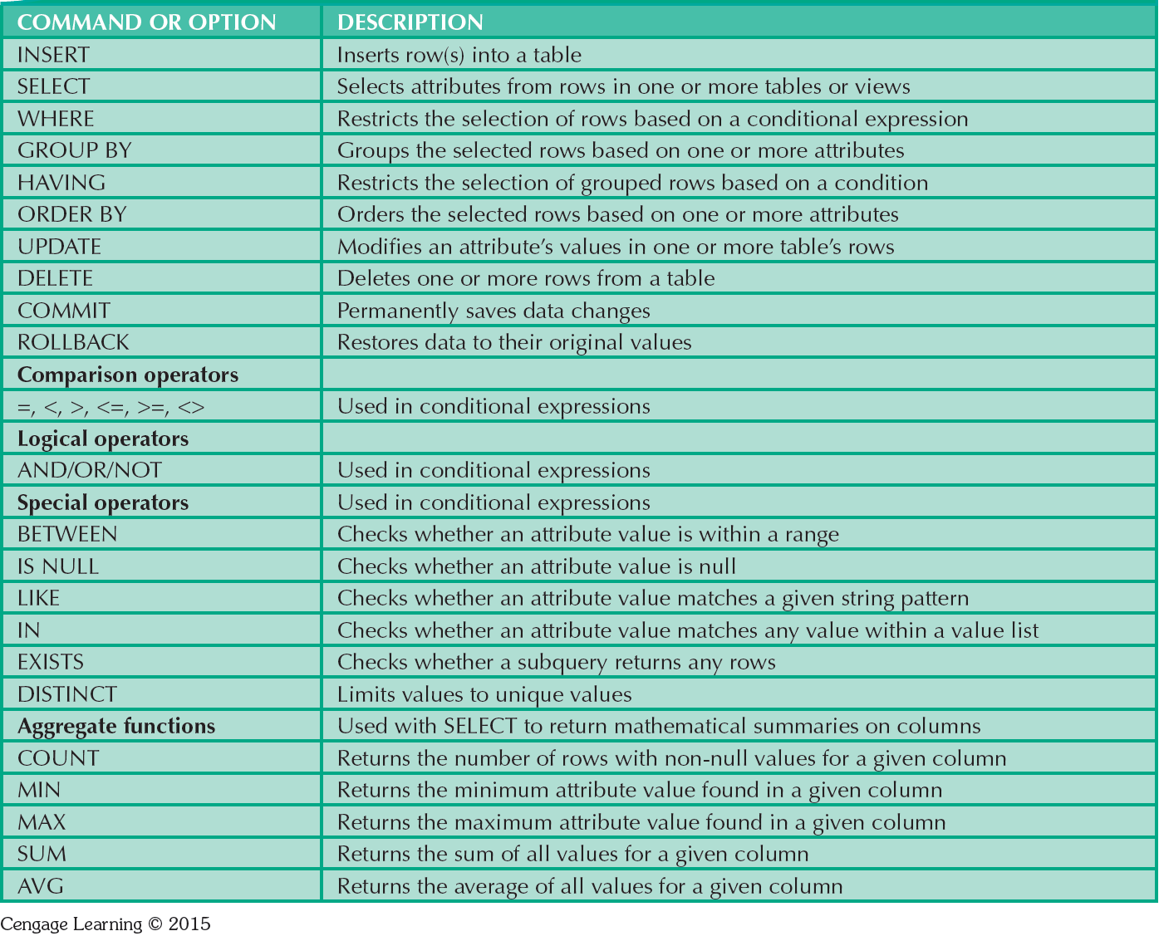
Table 7.2 - SQL Data Manipulation Commands

Slide 6
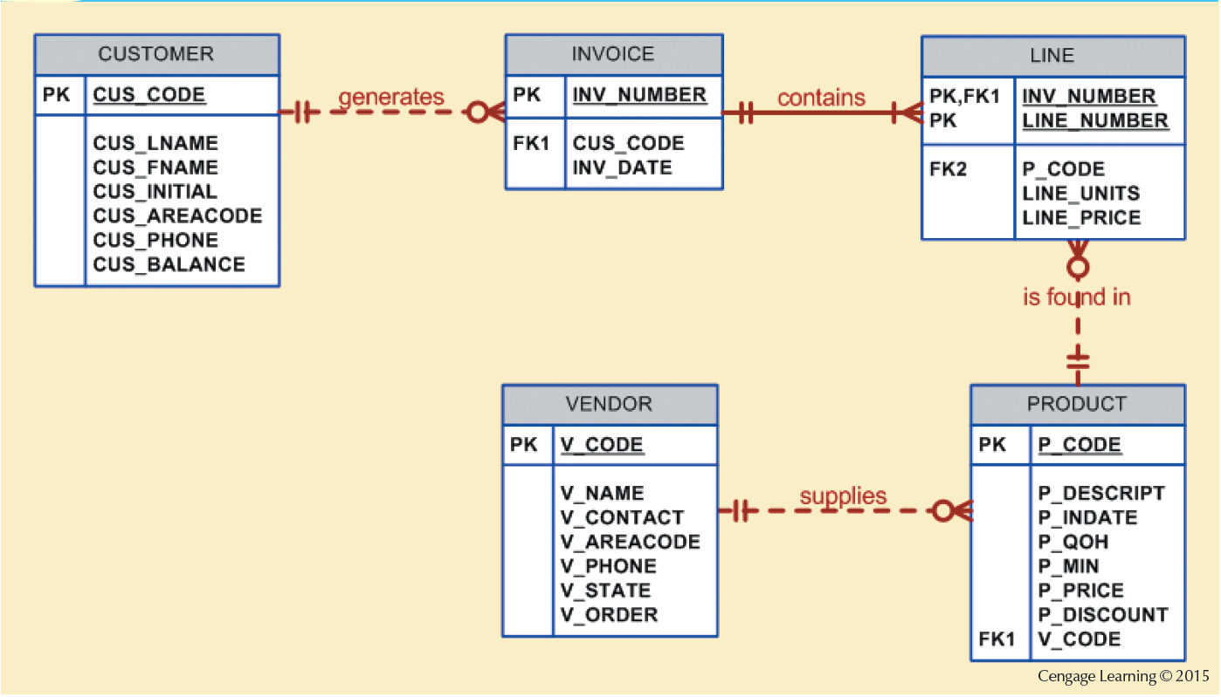
Figure 7.1 - The Database Model

Slide 7
Tasks to be Completed Before Using a New RDBMS
Create database structure
  RDBMS creates physical files that will hold database
  Differs from one RDBMS to another (interacting with the operating system and the file systems supported by the operation systems)
Authentication: Process DBMS uses to verify that only registered users access the data
  Required for the creation tables
  User should log on to RDBMS using user ID and password created by database administrator

Slide 8
The Database Schema
Logical group of database objects related to each other, such as tables and indexes.
Command
  CREATE SCHEMA AUTHORIZATION {creator};
    Seldom used directly
    When a user is created, the DBMS automatically assigns a schema to that user

Slide 9
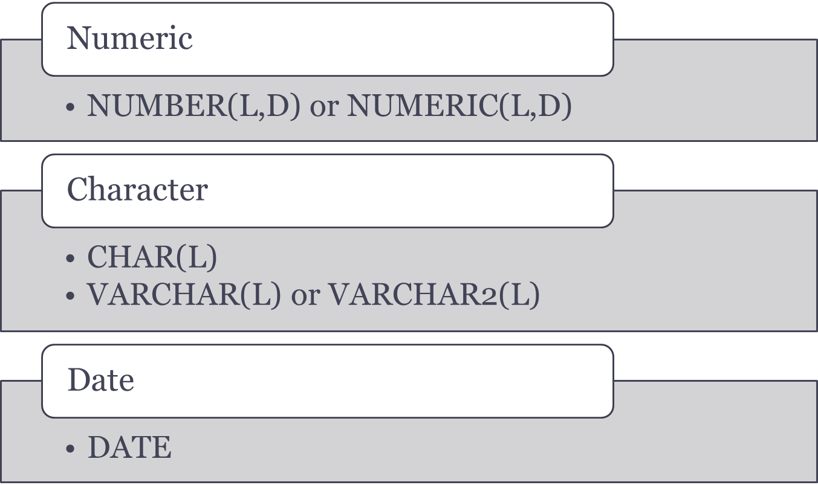
Common SQL Data Types

Slide 10
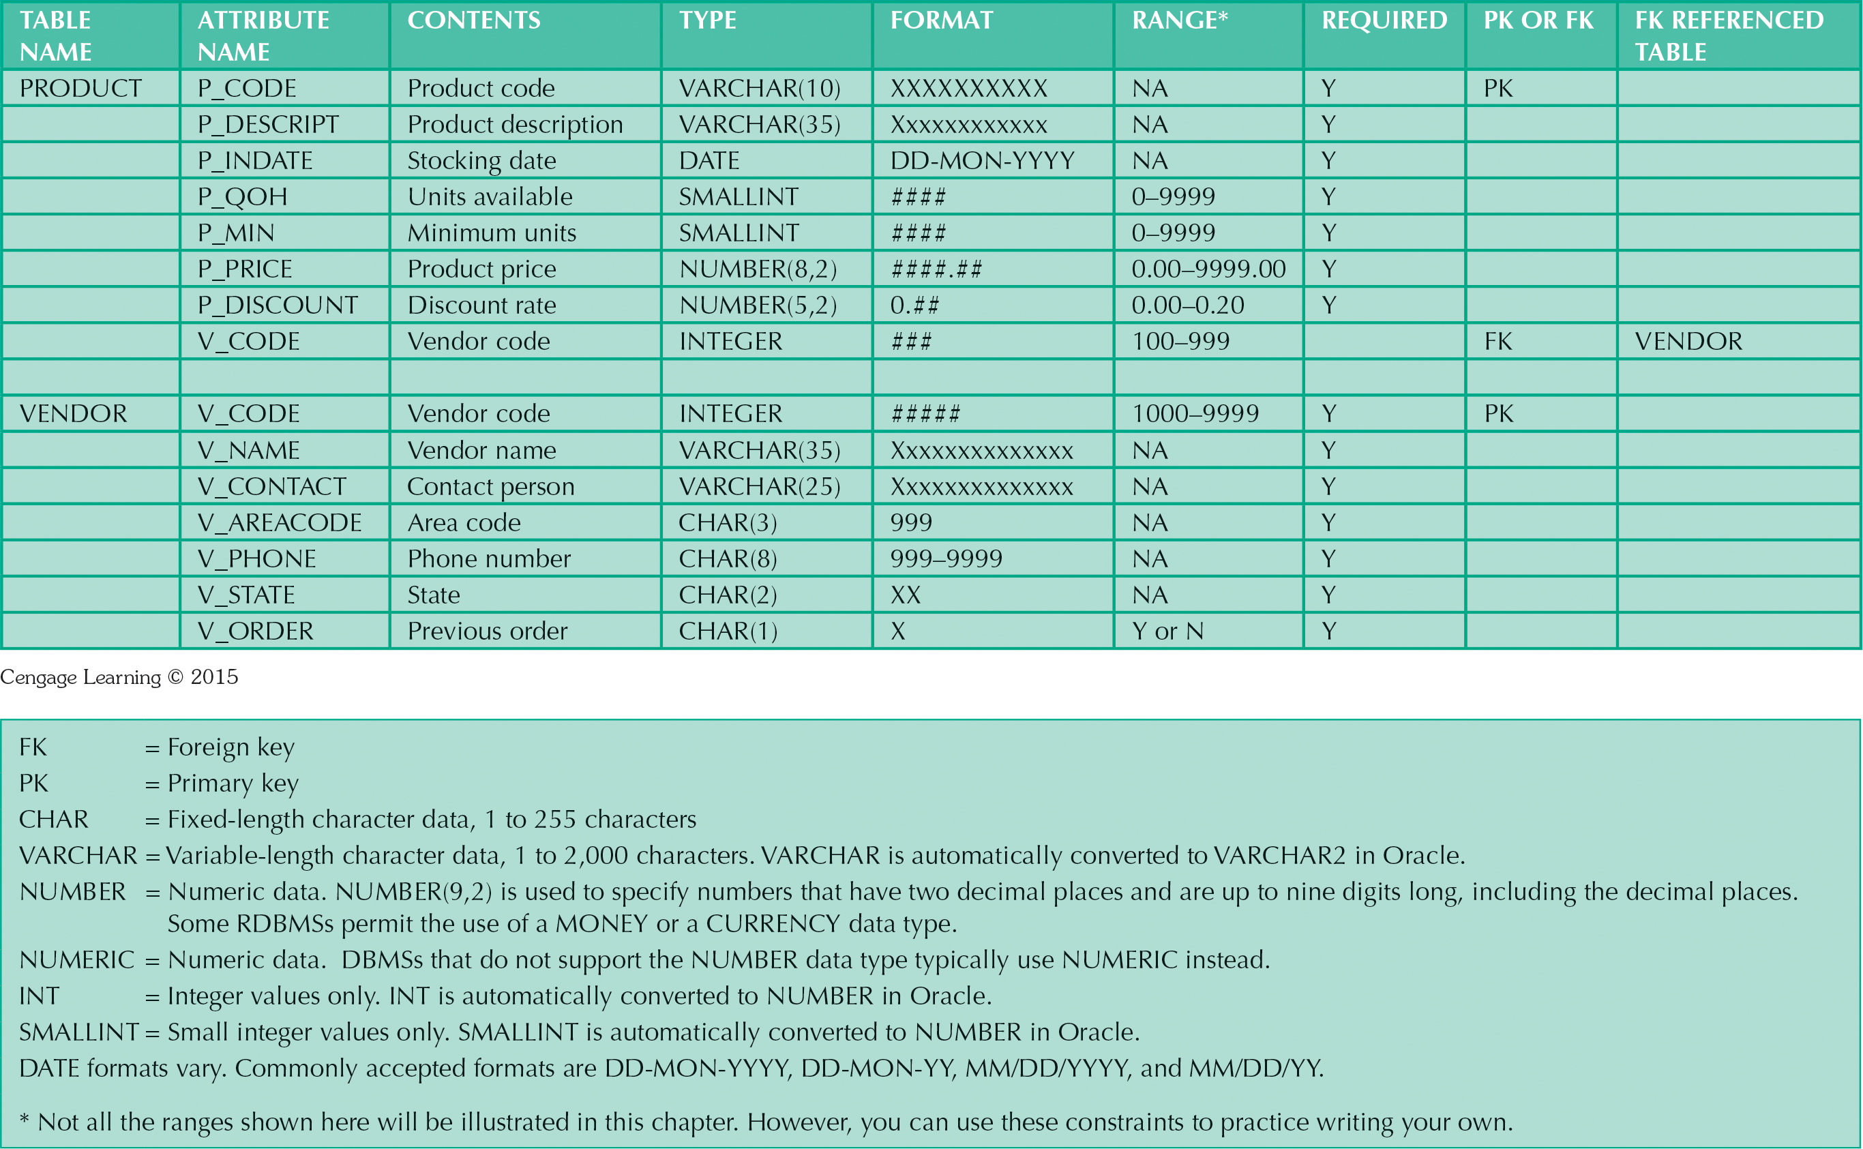


Slide 11
Creating Table Structures
Use one line per column (attribute) definition
Use spaces to line up attribute characteristics and constraints
Table and attribute names are capitalized
Features of table creating command sequence
  NOT NULL specification
  UNIQUE specification
Syntax to create table
  CREATE TABLE tablename();

Slide 12
Creating Table Structures
My SQL:
    CREATE TABLE INVOICE (
    INV_NUMBER int NOT NULL UNIQUE,
    CUS_CODE int NOT NULL,
    INV_DATE datetime NOT NULL,
    PRIMARY KEY(INV_NUMBER));
    INSERT INTO INVOICE VALUES('1001','10014','2014-1-16');
    INSERT INTO INVOICE VALUES('1002','10011','2014-1-16');
    INSERT INTO INVOICE VALUES('1003','10012','2014-1-16');
    INSERT INTO INVOICE VALUES('1004','10011','2014-1-17');
    INSERT INTO INVOICE VALUES('1005','10018','2014-1-17');
    INSERT INTO INVOICE VALUES('1006','10014','2014-1-17');
    INSERT INTO INVOICE VALUES('1007','10015','2014-1-17');
    INSERT INTO INVOICE VALUES('1008','10011','2014-1-17');

Slide 13
Primary Key and Foreign Key
Primary key attributes contain both a NOT NULL and a UNIQUE specification
RDBMS will automatically enforce referential integrity for foreign keys
Command sequence ends with semicolon

Slide 14
SQL Constraints
NOT NULL
  Ensures that column does not accept nulls
UNIQUE
  Ensures that all values in column are unique
DEFAULT
  Assigns value to attribute when a new row is added to table
CHECK
  Validates data when attribute value is entered

Slide 15
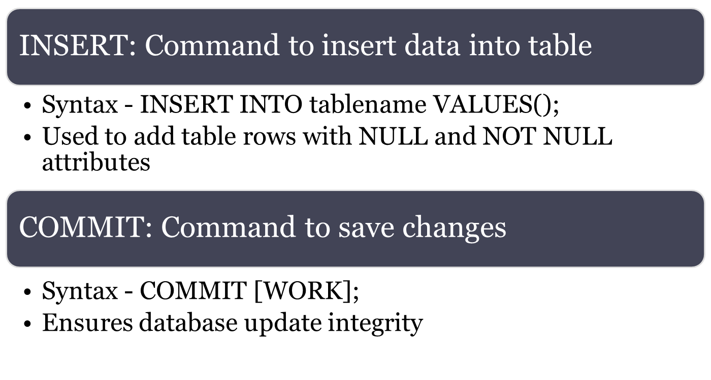
Data Manipulation Commands

Slide 16
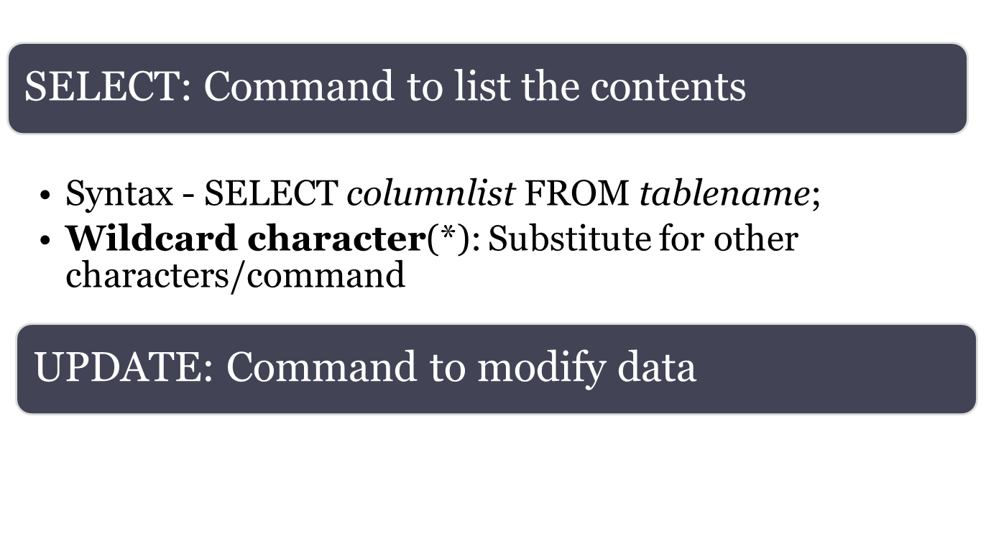
Data Manipulation Commands
UPDATE PRODUCT
SET P_INDATE= '11/1/1111'
WHERE P_CODE='13-Q2/P2';

Slide 17
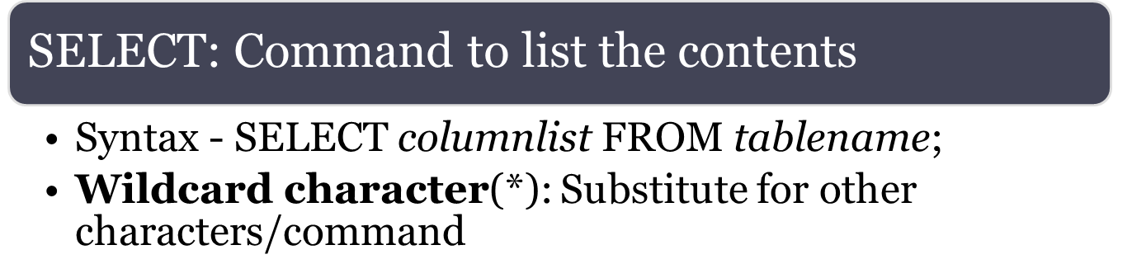
Data Manipulation Commands
SELECT P_DESCRIPT,P_INDATE,P_PRICE,V_CODE
FROM product
WHERE V_CODE=21344;
SELECT P_DESCRIPT,P_INDATE,P_PRICE,V_CODE
FROM product
WHERE V_CODE<>21344;

Slide 18
Data Manipulation Commands
Select Product table attributes with a P_PRICE restriction
SELECT P_DESCRIPT, P_QOH,P_MIN,P_PRICE
FROM PRODUCT
WHERE P_PRICE<=10;
Using comparison Operator on Character attributes
SELECT P_CODE,P_DESCRIPT, P_QOH,P_MIN,P_PRICE
FROM PRODUCT
WHERE P_CODE<='1558-QW1';

Slide 19
Data Manipulation Commands
List all of the rows in which the inventory stock dates occur on or after January 20,2014
SELECT P_DESCRIPT,P_QOH,P_MIN,P_PRICE,P_INDATE
FROM PRODUCT
WHERE P_INDATE>=‘01/20/2014';
Select statement with a computed column as an alias
SELECT P_DESCRIPT,P_QOH,P_PRICE,P_QOH*P_PRICE AS TOTVALUE
FROM product;

Slide 20
Comparison Operators: Computed Columns and Column Aliases
SQL accepts any valid expressions/formulas in the computed columns
Alias: Alternate name given to a column or table in any SQL statement to improve the readability
Computed column, an alias, and date arithmetic can be used in a single query

Slide 21
Data Manipulation Commands
Get a list of out-of-warranty products that have been stored more than 90 days. (P_INDATE is at least 90 days less than the current date)
SELECT P_CODE, P_INDATE, sysdate -90
FROM PRODUCT
WHERE P_INDATE<=sysdate-90;
Get a list of all products, the dates they were received, and the warranty expiration date (90 days from receiving the product)
SELECT P_CODE, P_INDATE, P_INDATE+90 AS EXPDATE
FROM PRODUCT;

Slide 22
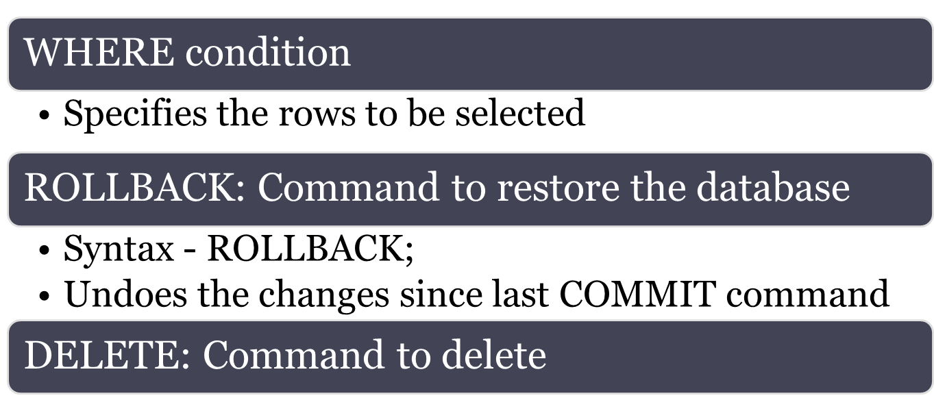
Data Manipulation Commands
DELETE FROM product
WHERE P_MIN=5;

Slide 23
Selecting Rows Using Conditional Restrictions
Following syntax enables to specify which rows to select
  SELECT columnlist
  FROM tablelist
  [WHERE conditionlist];
Used to select partial table contents by placing restrictions on the rows
Optional WHERE clause
  Adds conditional restrictions to the SELECT statement

Slide 24
Comparison Operators
Add conditional restrictions on selected table contents
Used on:
  Character attributes
  Dates

Slide 25
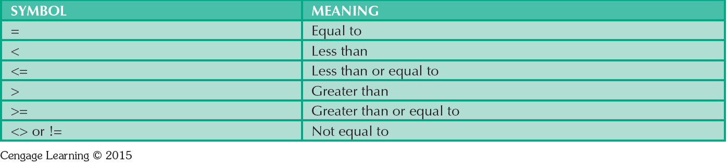
Table 7.6 - Comparison Operators

Slide 26
Arithmetic operators
The Rule of Precedence: Establish the order in which computations are completed
Perform:
  Operations within parentheses
  Power operations
  Multiplications and divisions
  Additions and subtractions

Slide 27
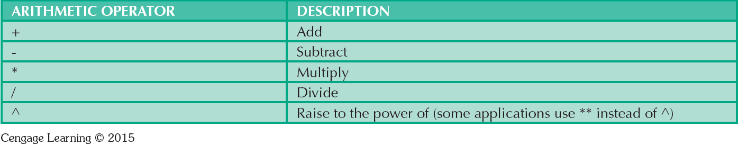
Table 7.7 - The Arithmetic Operators

Slide 28
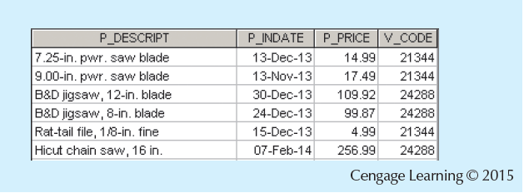
Figure 7.12 - Selected PRODUCT Table Attributes: The logical OR
SELECT P_DESCRIPT,P_INDATE,P_PRICE,V_CODE
FROM product
WHERE V_CODE=21344 OR V_CODE=24288;

Slide 29
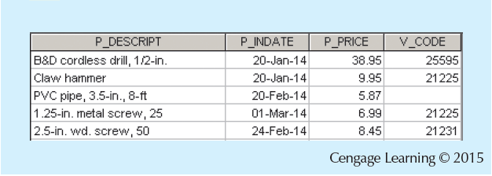
Figure 7.13 - Selected PRODUCT Table Attributes: The Logical AND
SELECT P_DESCRIPT,P_INDATE,P_PRICE,V_CODE
FROM product
WHERE P_PRICE<50
AND P_INDATE>'01/15/2014';

Slide 30
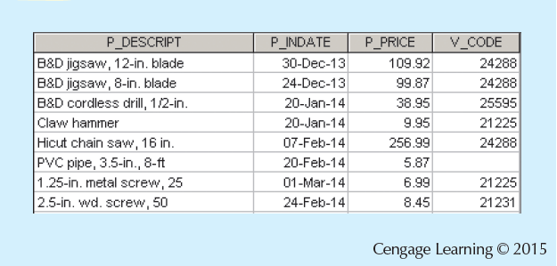
Figure 7.14 - Selected PRODUCT Table Attributes: The Logical AND and OR
SELECT P_DESCRIPT,P_INDATE,P_PRICE,V_CODE
FROM product
WHERE (P_PRICE<50 AND P_INDATE>'01/15/2014') OR V_CODE=24288;

Slide 31
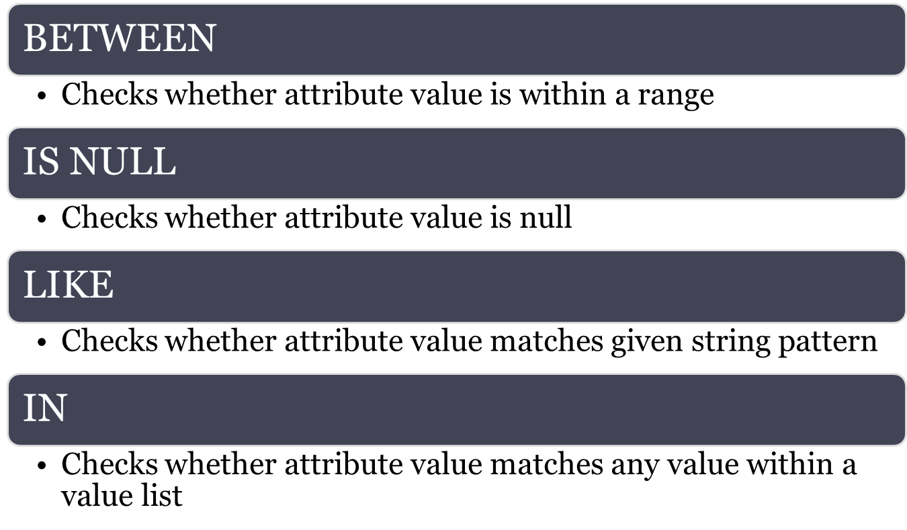
Special Operators

Slide 32
Special Operators
Get a list for all products whose prices are between $5 and $10.
SELECT * FROM product
WHERE P_PRICE BETWEEN 5 AND 10;
Get a list for all products that do not have a vendor assigned.
SELECT P_CODE, P_DESCRIPT, V_CODE
FROM PRODUCT
WHERE V_CODE IS NULL;

Slide 33
Special Operators
  Find all VENDOR rows for contacts whose last names begin with Smith.
SELECT V_NAME,V_CONTACT,V_AREACODE,V_PHONE
FROM vendor
WHERE V_CONTACT LIKE 'Smith%';
  Find all VENDOR rows for contacts whose last names not begin with Smith.
SELECT V_NAME,V_CONTACT,V_AREACODE,V_PHONE
FROM vendor
WHERE V_CONTACT NOT LIKE 'Smith%';

Slide 34
Special Operators
  Find all VENDOR rows for V_CODE in (21344, 24288)
SELECT *
FROM product
WHERE V_CODE IN ('21344','24288');
  List all vendors, but only if there are products with the quantity on hand, and less than double the minimum quantity.
SELECT *
FROM vendor
WHERE EXISTS (SELECT * FROM PRODUCT WHERE P_QOH<P_MIN*2);

Slide 35
Advanced Data Definition Commands
ALTER TABLE command: To make changes in the table structure
ALTER TABLE invoice ENGINE = InnoDB
Keywords use with the command
  ADD - Adds a column
  MODIFY - Changes column characteristics
  DROP - Deletes a column
Used to:
  Add table constraints
  Remove table constraints

Slide 36
Changing Column’s Data Type
ALTER can be used to change data type
Some RDBMSs do not permit changes to data types unless column is empty
Syntax –
  ALTER TABLE tablename MODIFY (columnname(datatype));

Slide 37
Changing Column’s Data Characteristics
Use ALTER to change data characteristics
Changes in column’s characteristics are permitted if changes do not alter the existing data type
Syntax
  ALTER TABLE tablename MODIFY (columnname(characterstic));
ALTER TABLE product
MODIFY V_CODE integer;

Slide 38
Adding Column, Dropping Column
Adding a column
  Use ALTER and ADD
  Do not include the NOT NULL clause for new column
ALTER TABLE product
ADD (P_SALECODE CHARACTER);

Slide 39
Adding Column, Dropping Column
Dropping a column
  Use ALTER and DROP
  Some RDBMSs impose restrictions on the deletion of an attribute
ALTER TABLE VENDOR
DROP COLUMN V_ORDER;

Slide 40
Advanced Data Updates
UPDATE command updates only data in existing rows
If a relationship is established between entries and existing columns, the relationship can assign values to appropriate slots
Arithmetic operators are useful in data updates
In Oracle, ROLLBACK command undoes changes made by last two UPDATE statements
UPDATE PRODUCT
SET P_QOH=22222222
WHERE P_CODE='1546-QQ2';

Slide 41
Inserting Table Rows with a
SELECT Subquery
Syntax
  INSERT INTO tablename SELECT columnlist FROM tablename
Used to add multiple rows using another table as source
SELECT command - Acts as a subquery and is executed first
  Subquery: Query embedded/nested inside another query

Slide 42
Copying Parts of Tables
SQL permits copying contents of selected table columns
  Data need not be reentered manually into newly created table(s)
Table structure is created
Rows are added to new table using rows from another table

Slide 43
Copying Parts of Tables
CREATE TABLE PART AS
SELECT P_CODE AS PART_CODE, P_DESCRIPT AS PART_DESCRIPT,P_PRICE AS PART_PRICE, V_CODE
FROM PRODUCT;

Slide 44
Additional SELECT Query Keywords
Logical operators work well in the query environment
SQL provides useful functions that:
  Counts
  Find minimum and maximum values
  Calculate averages
SQL allows user to limit queries to entries:
  Having no duplicates
  Whose duplicates may be grouped

Slide 45
Ordering a Listing
ORDER BY clause is useful when listing order is important
Syntax - SELECT columnlist
FROM tablelist
[WHERE conditionlist]
[ORDER BY columnlist [ASC | DESC]];
Cascading order sequence: Multilevel ordered sequence
  Created by listing several attributes after the ORDER BY clause

Slide 46
Listing Unique Values
DISTINCT clause: Produces list of values that are unique
Syntax - SELECT DISTINCT columnlist
  FROM tablelist;
Access places nulls at the top of the list
  Oracle places it at the bottom
  Placement of nulls does not affect list contents

Slide 47
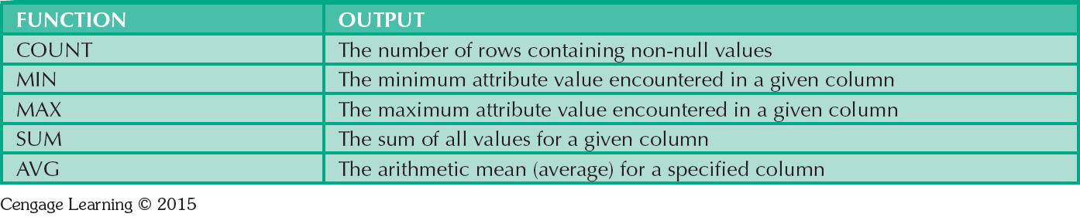
Table 7.8 - Some Basic SQL Aggerate Functions

Slide 48
Grouping Data
Frequency distributions created by GROUP BY clause within SELECT statement
Syntax - SELECT columnlist
  FROM tablelist
  [WHERE conditionlist]
  [GROUP BY columnlist]
  [ORDER BY columnlist [ASC | DESC]];

Slide 49
Joining Database Tables
Performed when data are retrieved from more than one table at a time
  Equality comparison between foreign key and primary key of related tables
Tables are joined by listing tables in FROM clause of SELECT statement
  DBMS creates Cartesian product of every table in the FROM clause

Slide 50
Joining Tables With an Alias
Alias identifies the source table from which data are taken
Any legal table name can be used as alias
Add alias after table name in FROM clause
  FROM tablename alias

